Slide 1
The UDP Protocol and Attacks

Slide 2
Outline
Transport layer protocol
Port number
UDP protocol
Attacks using UDP

Slide 3
User Datagram Protocol (UDP)
Connectionless transport layer protocol
no handshaking between UDP sender and receiver
each UDP segment handled independently of others
A UDP socket is fully identified by a two-tuple consisting of a destination IP address and a destination port number
Best effort service
UDP segments may be lost
UDP segments may be delivered out-of-order

Slide 4
Port Number: Why Need It
Analogy
IP Address: address of machines
Port number: address of applications (within a machine)
 | Mailing Address
IP address | Apartment building’s street address
Port number | Apartment number

Slide 5
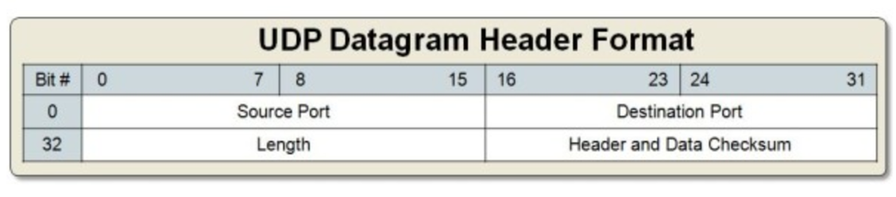
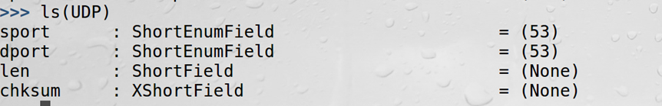
UDP Header
UDP header structure
Scapy UDP class
Notes:
Note: checksum is optional for IPv4. Set this field to zero if we want the receiver not to check the checksum.

Slide 6
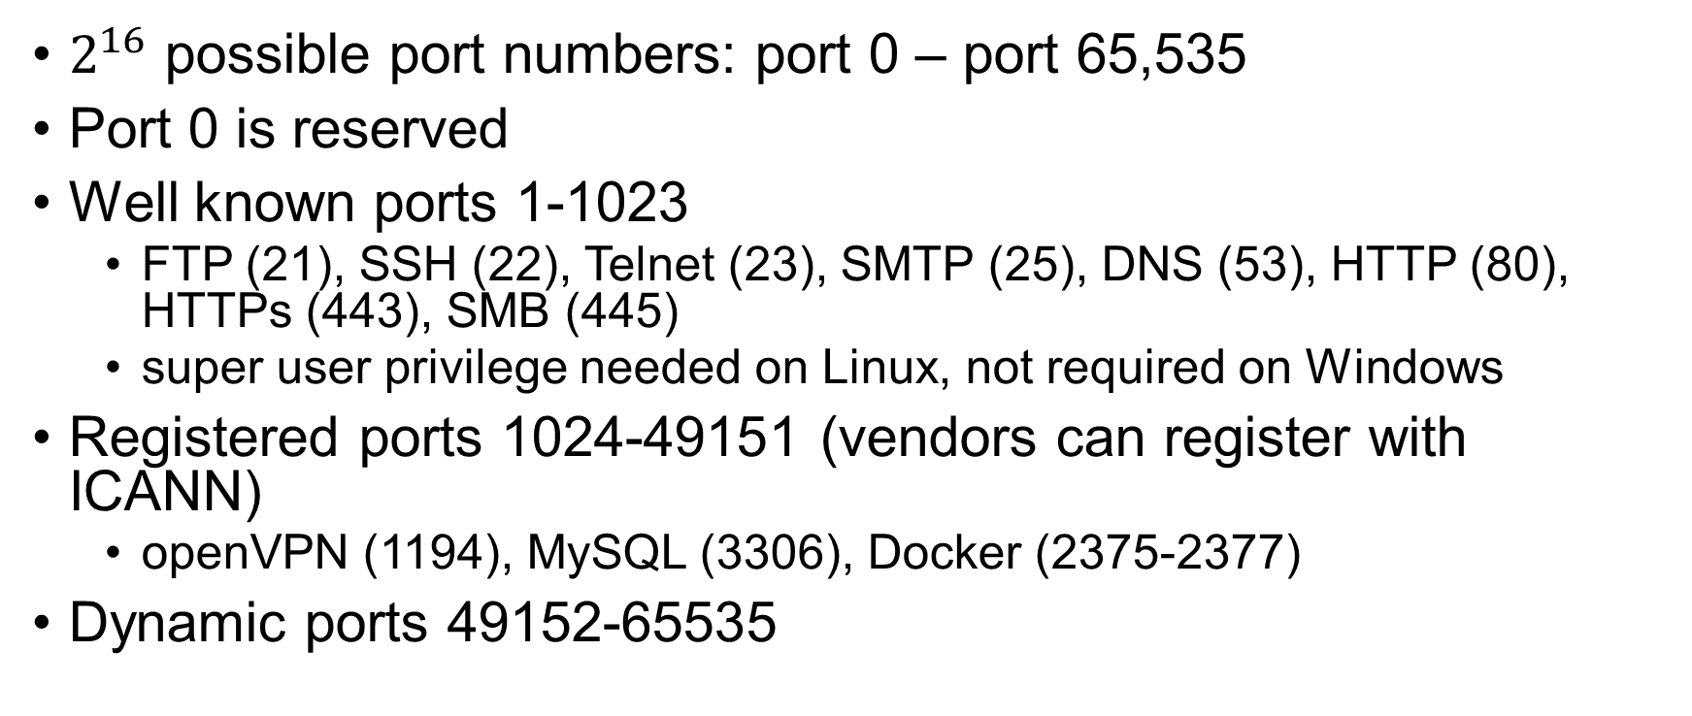
Port Numbers
$2^{16}$ possible port numbers: port 0 – port 65,535
Port 0 is reserved
Well known ports 1-1023
FTP (21), SSH (22), Telnet (23), SMTP (25), DNS (53), HTTP (80), HTTPs (443), SMB (445)
super user privilege needed on Linux, not required on Windows
Registered ports 1024-49151 (vendors can register with ICANN)
openVPN (1194), MySQL (3306), Docker (2375-2377)
Dynamic ports 49152-65535

Slide 7
Transport Layer Protocols
Properties | TCP | UDP
Connections | √
Packet boundary |  | √
Reliability | √
Ordering | √
Speed |  | Faster
Broadcast |  | √

Slide 8
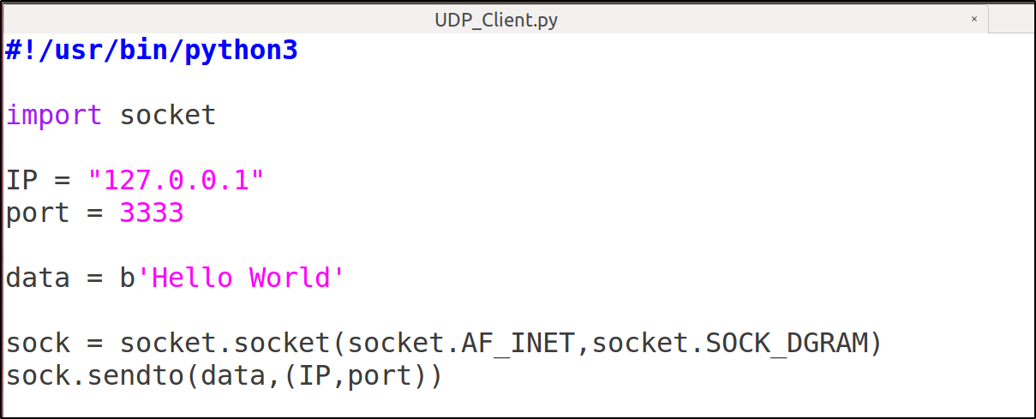
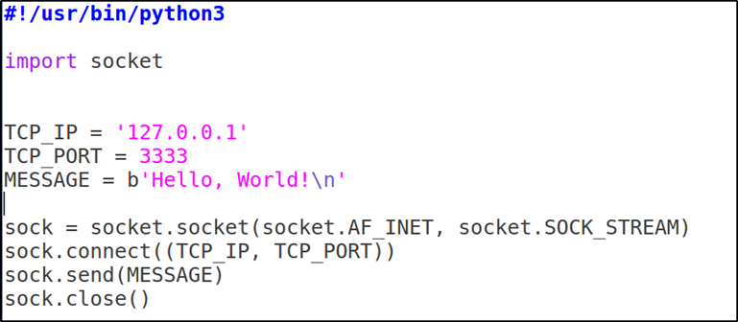
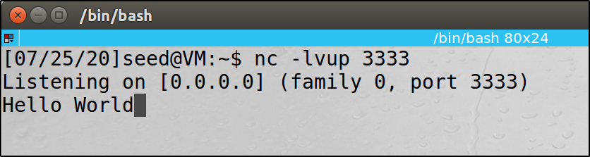
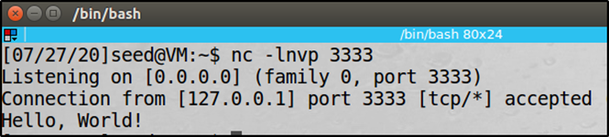
UDP Client

Slide 9
Source Port Number
Application does not specify one
OS will assign a random source port number
Common for most client programs
Application specifies one
not common for client
needed for server

Slide 10
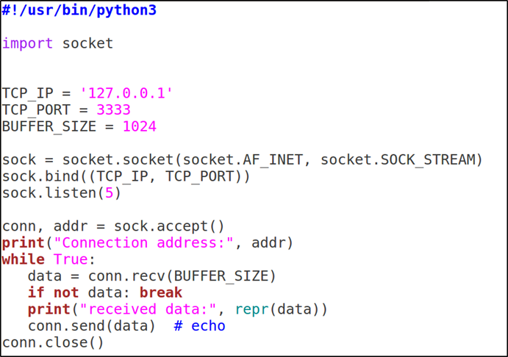
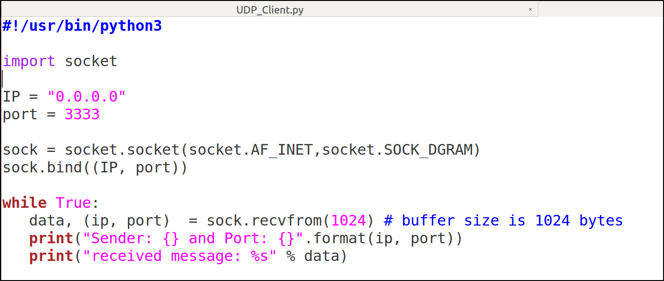
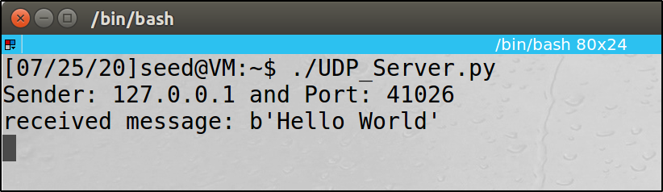
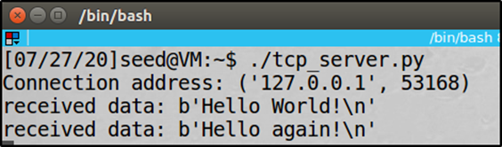
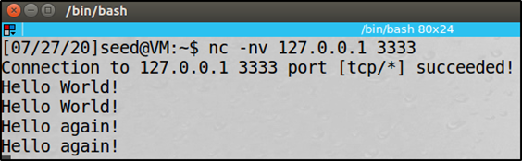
UDP Server

Slide 11
UDP Applications
DNS Protocol
Port number: 53
Video/Audio Streaming, Skype, Zoom
Netflix and YouTube use TCP (no need for real time)
Real-Time Applications

Slide 12
Question
UDP does not preserve order and does not handle packet loss. If an application does care about packet loss and order, can it still use UDP?
Notes:
Yes. The application needs to handle the order and packet loss by itself, instead of relying on the protocol to handle them.

Slide 13
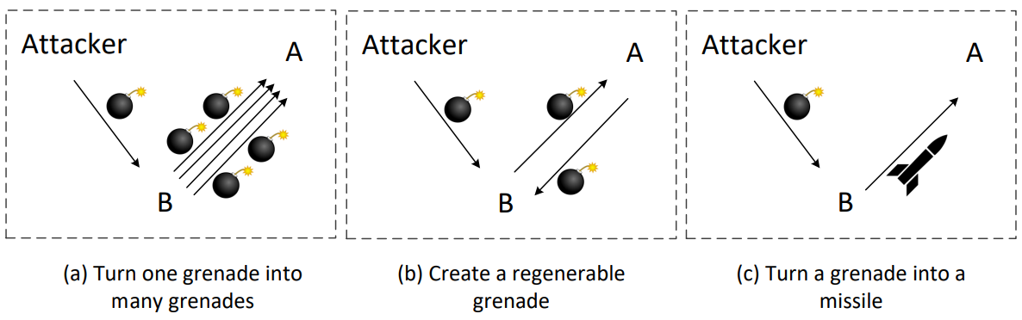
UDP Attack
Mostly used for Denial-Of-Service (DOS) Attacks
Strategies: magnify attacking power

Slide 14
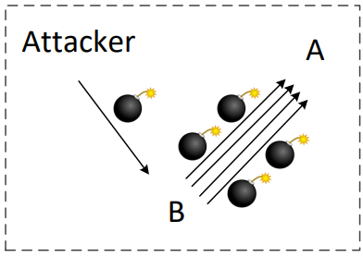
Strategy 1: Turn One Grenade into Many
Example: Smurf Attack (ICMP), Fraggle Attack (UDP)

Slide 15
Fraggle Attack
A Fraggle attack is a variation of a Smurf attack where an attacker sends a large amount of UDP traffic to ports 7 (Echo) and 19 (CHARGEN)
Many computers on the network will respond to this traffic by sending traffic back to the spoofed source IP of the victim, flooding it with traffic.

Slide 16
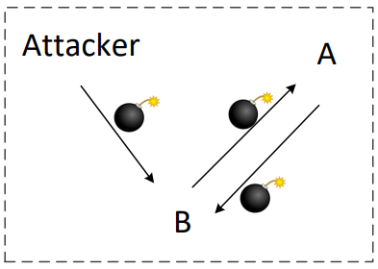

Strategy 2: Create Regenerable Grenade
Example: UDP Ping Pong Attack

Slide 17
UDP Flood Ping-Pong Attack
UDP flood attack takes advantage of the chargen and echo ports, which is used legitimately to test hosts and networks
Attacker sends a malformed UDP packet to chargen port (19) of host A, with source address of host B and source port as echo (7)
Host A sends random character string to echo port of host B. Host B replies it back to chargen port of host A since port 7 just echoes whatever is sent to it
This sequence run infinitely between A and B. Consuming bandwidth and processing power of targets

Slide 18

UDP Flood Ping-Pong Attack
Step 2
src_ip = A, src_port = 19
dst_ip = B, dst_port = 7
Computer A
Computer B
Step 3
src_ip = B, src_port = 7
dst_ip = A, dst_port = 19
Step 1
src_ip = B, src_port = 7
dst_ip = A, dst_port = 19
Attacker

Slide 19
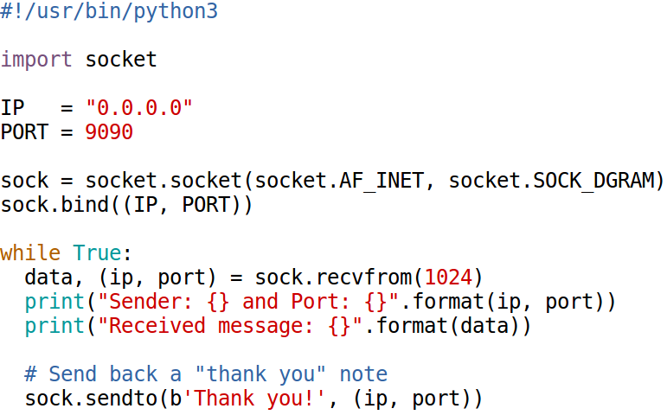
UDP Ping Pong Attack: Vulnerable Server

Slide 20
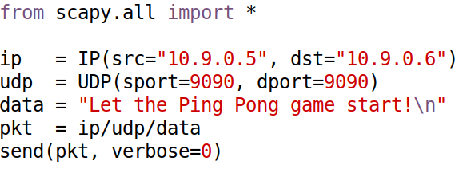
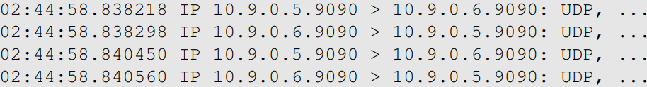
UDP Ping Pong Attack: Attack
Attack results (look at the timestamp to see how fast the Ping Pong ball is):
Notes:
Fun fact: If we convert this into real Ping Pong on a real Ping Pong table, this ball is
traveling at a speed of 5200 meters per second, about Mach 10.

Slide 21
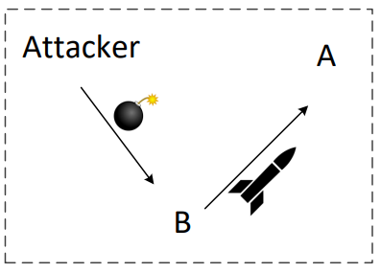
Strategy 3: Turn Grenade to Missile
Example: UDP Amplification Attack

Slide 22
UDP Amplification Attack
Certain commands to UDP protocols elicit responses that are much larger than the initial request
A single packet can generate between 10 and 100 times the original bandwidth

Slide 23
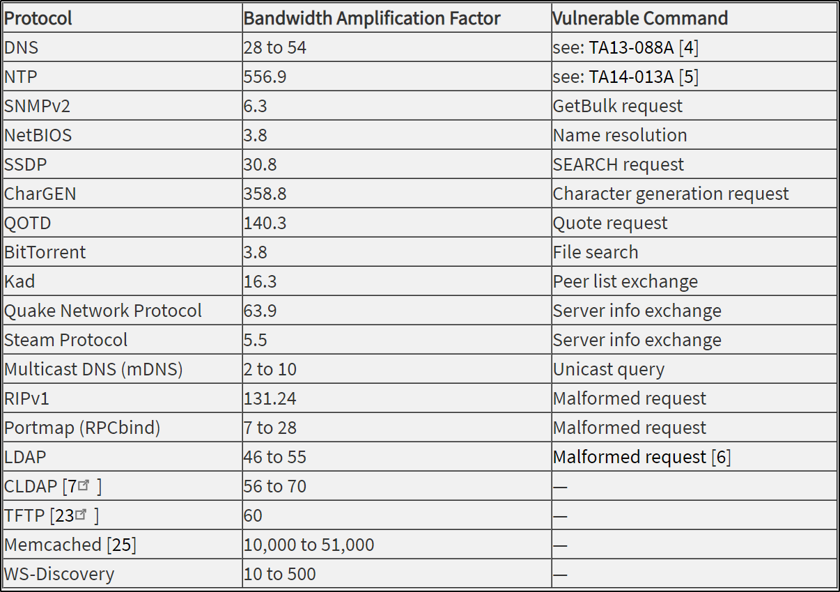
Bandwidth Amplification Factor
Source: National Cyber Awareness System

